Slide 1
Project Presentation
Lu Zhang

Slide 2
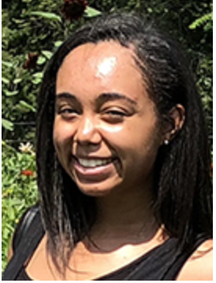





Siani Barbosa
Functional Neural Circuits
Circuit mechanisms underlying cortical communications
Structural organization of cortical subnetworks
Ana Inacio, Lu Zhang, Mei Han
Mei Han
In vivo two-photon calcium imaging, neuropharmacology, single-cell based monosynaptic input tracing in whole brain,
holographic imaging and photo-stimulation
Development of functional subnetworks in cortex
Ana Inacio, Lu Zhang, Mei Han
Ana Inacio
Longitudinal two-photon calcium imaging during development, optogenetics, multiplex ISH,
3D reconstruction of body movement, holographic imaging and photo-stimulation
Development of cortical disinhibitory circuits
Shovan Naskar, Ana Inacio, Mei Han
Shovan Naskar
Whole-cell patch-clamp recordings in brain slices, optogenetic & chemogenetic stimulation,
in vivo two-photon calcium imaging, scRNA sequencing transcriptome
Changquan Ye
Cortico-cortical communication in NDDs
Shovan Naskar, Changquan Ye, Siani Barbosa, Mei Han
Behav. task for associative learning, whole-cell patch-clamp recordings in brain slices, in vivo electrophysiology
optogenetic & chemogenetic stimulation, in vivo two-photon calcium imaging
Lu Zhang
Higher-order thalamic nucleus in sensory perception
Changquan Ye, Jia Qi
Texture-discrimination behavior task, optogenetic & chemogenetic stimulation, photometry,
optogenetic & chemogenetic stimulation, in vivo electrophysiology

Slide 3
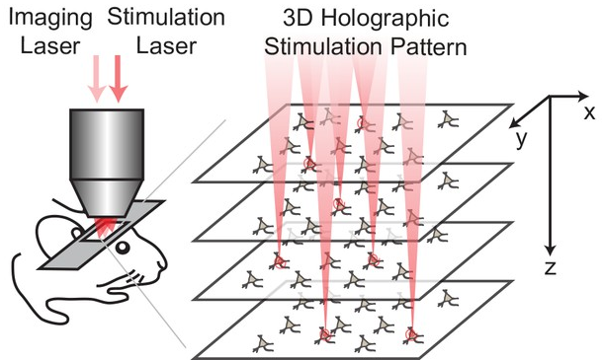
Holographic Imaging and Photo-Stimulation
Source: https://doi.org/10.7554/eLife.32671

Slide 4




Semi-Automatic Workflow
To ensure each cell has comparable response
Data for future offline analysis
Data for future offline analysis
2p Imaging ~20 min
Quick analysis
2p Imaging + Single cell stimulation ~20 min
Quick analysis
Identify the SLM parameters for each single cell
2P imaging + Holographic photo-stimulation
Data for future offline analysis
Bruker_PrairieLink
Bruker_PVLinkExcuteFolder
Bruker_PVLinkExcuteFolder
Identify ROI of each cell, and their behavioral dependency

Slide 5

Semi-Automatic Workflow
To ensure each cell has comparable response
Data for future offline analysis
Data for future offline analysis
2p Imaging ~20 min
Quick analysis
2p Imaging + Single cell stimulation ~30 min
Quick analysis
Identify the SLM parameters for each single cell
2P imaging + Holographic photo-stimulation
Data for future offline analysis
Bruker_PrairieLink
Bruker_PVLinkExcuteFolder
Bruker_PVLinkExcuteFolder
Identify ROI of each cell, and their behavioral dependency
Manual operation process
2p online Imaging
2p Imaging + Single cell stimulation
2P imaging + Holographic photo-stimulation
Data for future offline analysis
Manual identify ROI of each cell

Slide 6
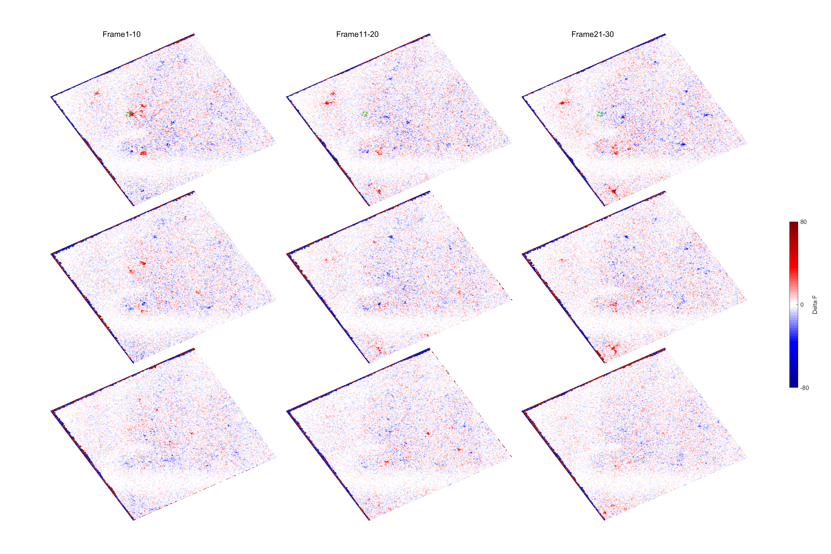
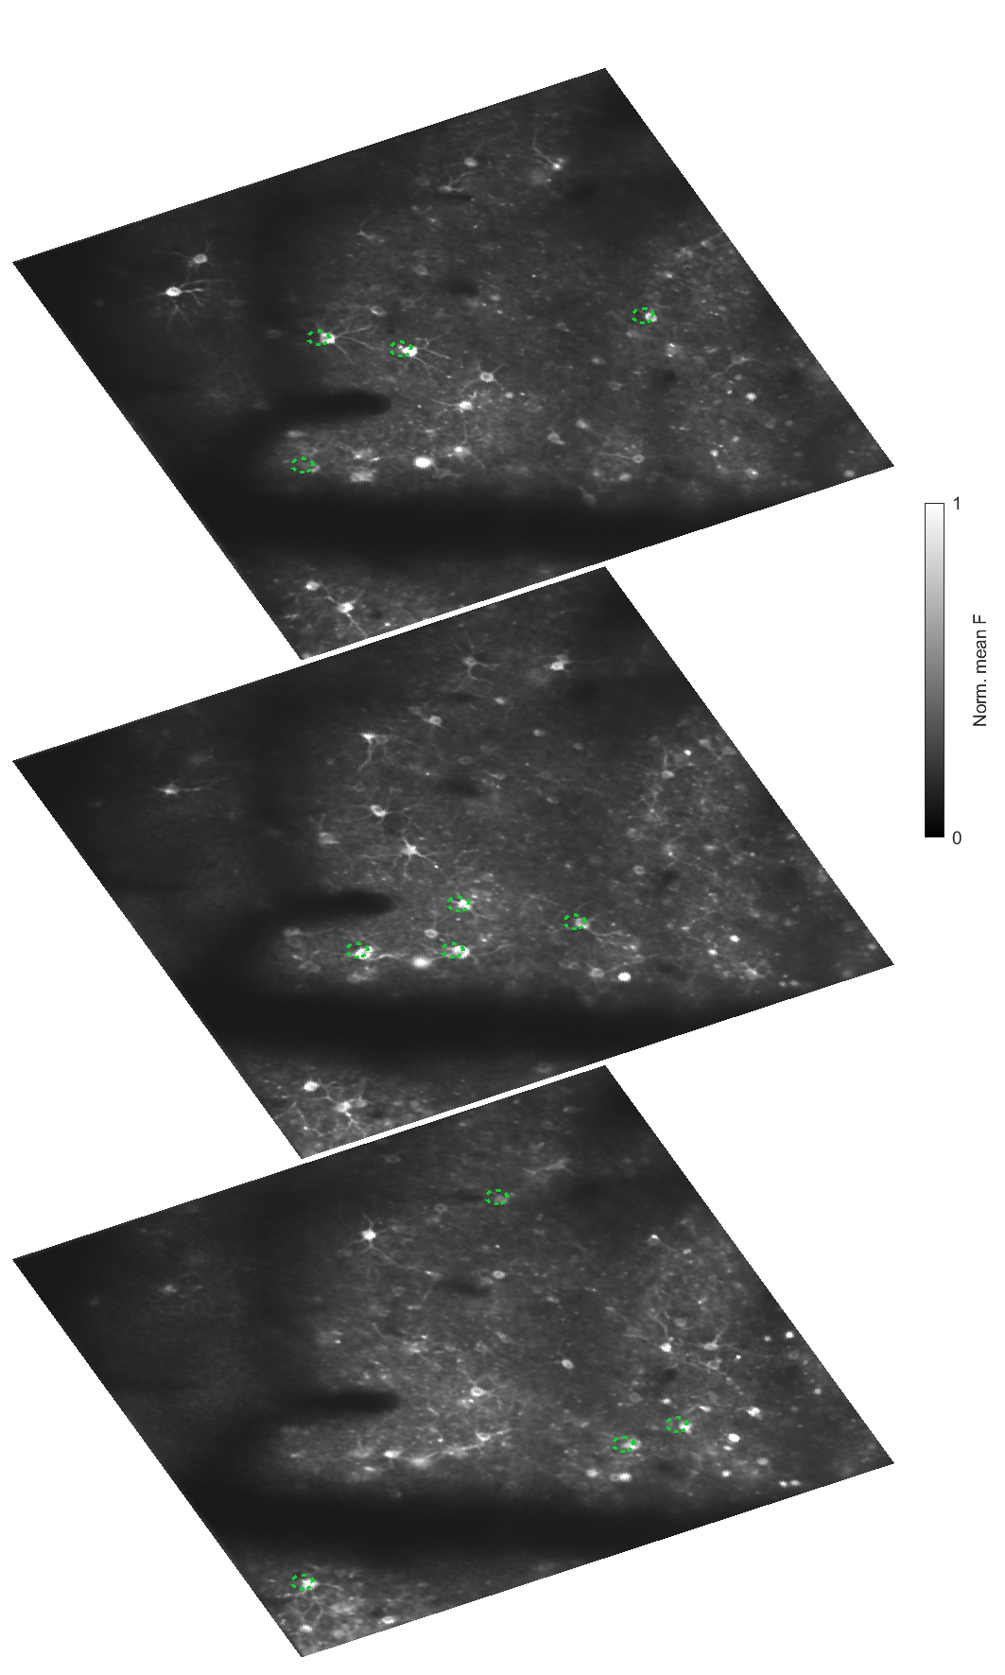
Single cell stimulation on plane 1
Manual operation process

Slide 7
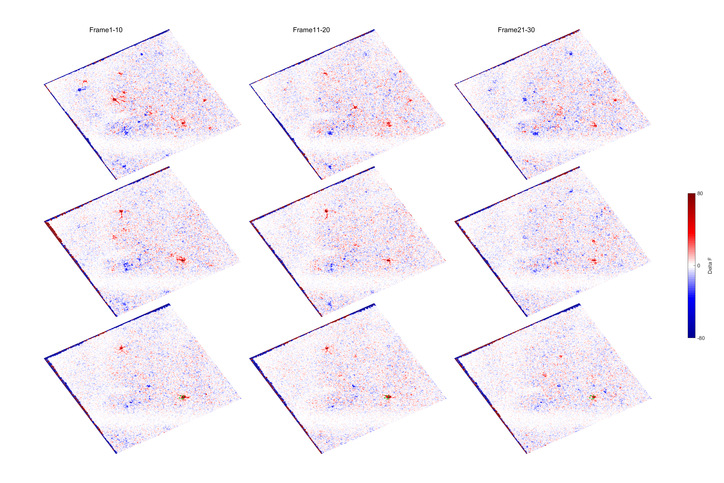
Single cell stimulation on plane 3

Slide 8
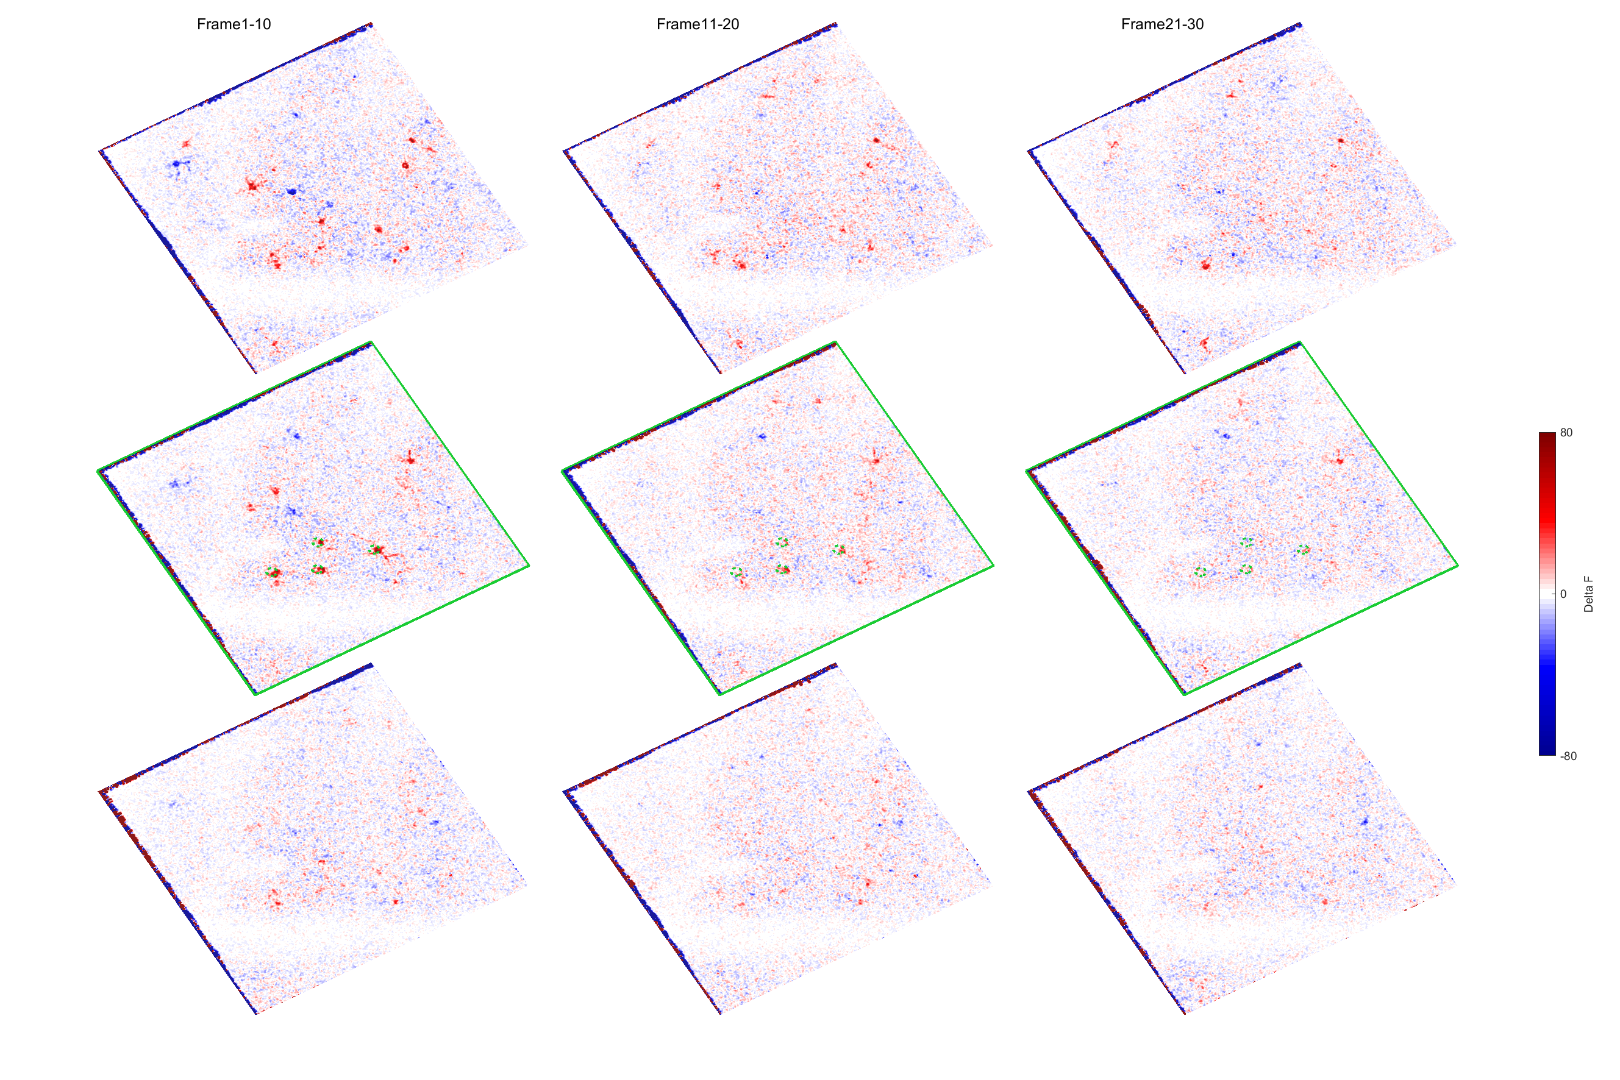
Group cell stimulation on plane 2

Slide 9
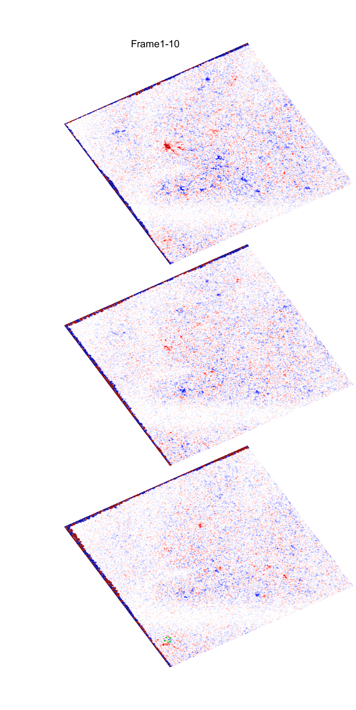
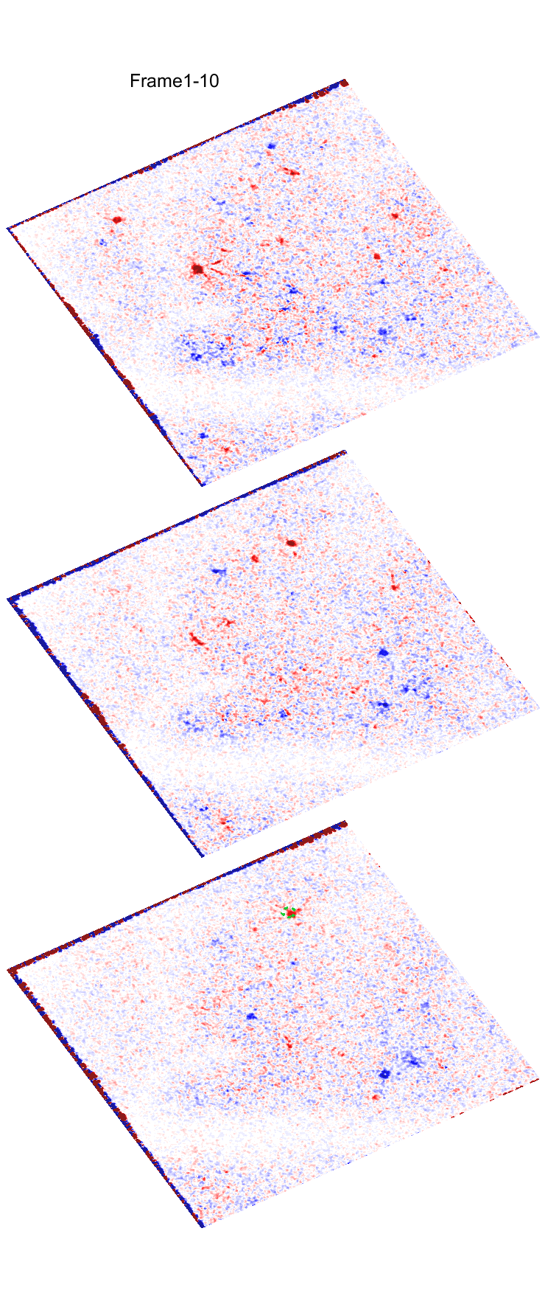
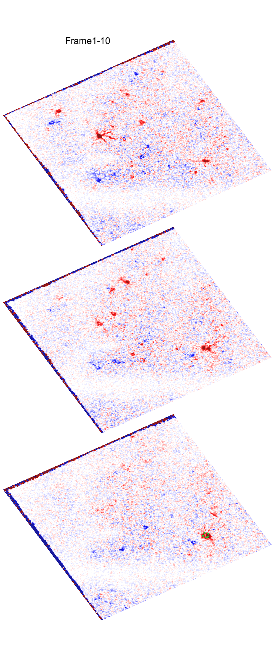
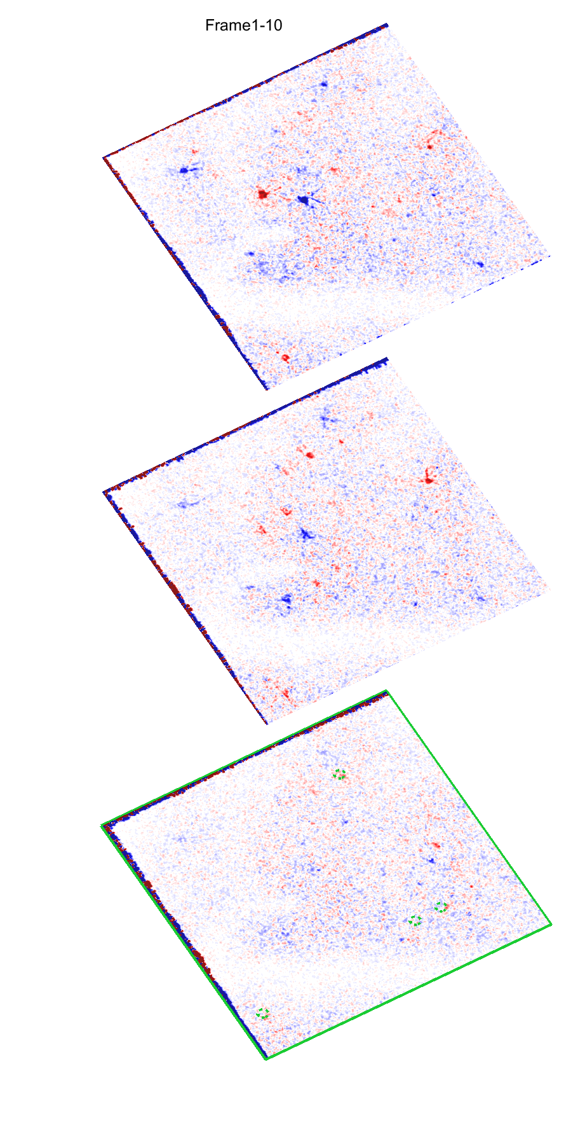
Network effect?
Single cell stimulation on plane 3
Group cell stimulation on plane 3

Slide 10
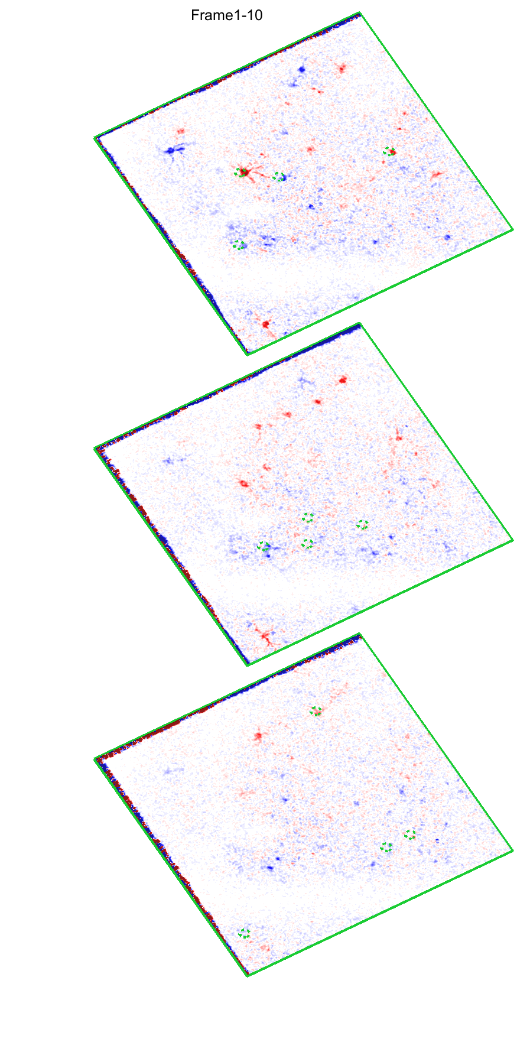
Network effect?
Group cell stimulation on plane 2
Group cell stimulation on 3 planes

Slide 11
Summary from Manual Testing
Individual cells were activated by single target opto-stimulation
Holographic stimulation of neural assemblies fails activating the targets probably due to network effect (indirection inhibition)
Manual operation process
2p online Imaging
2p Imaging + Single cell stimulation
2P imaging + Holographic photo-stimulation
Data for future offline analysis
Manual identify ROI of each cell

Slide 12
Holographic Imaging and Photo-Stimulation
To ensure each cell has comparable response
Data for future offline analysis
Data for future offline analysis
2p Imaging ~20 min
Quick analysis
2p Imaging + Single cell stimulation ~30 min
Quick analysis
Identify the SLM parameters for each single cell
2P imaging + Holographic photo-stimulation
Data for future offline analysis
Bruker_PrairieLink
Bruker_PVLinkExcuteFolder
Bruker_PVLinkExcuteFolder
Identify ROI of each cell, and their behavioral dependency
Manual operation process
2p online Imaging
2p Imaging + Single cell stimulation
2P imaging + Holographic photo-stimulation
Data for future offline analysis
Manual identify ROI of each cell

Slide 13
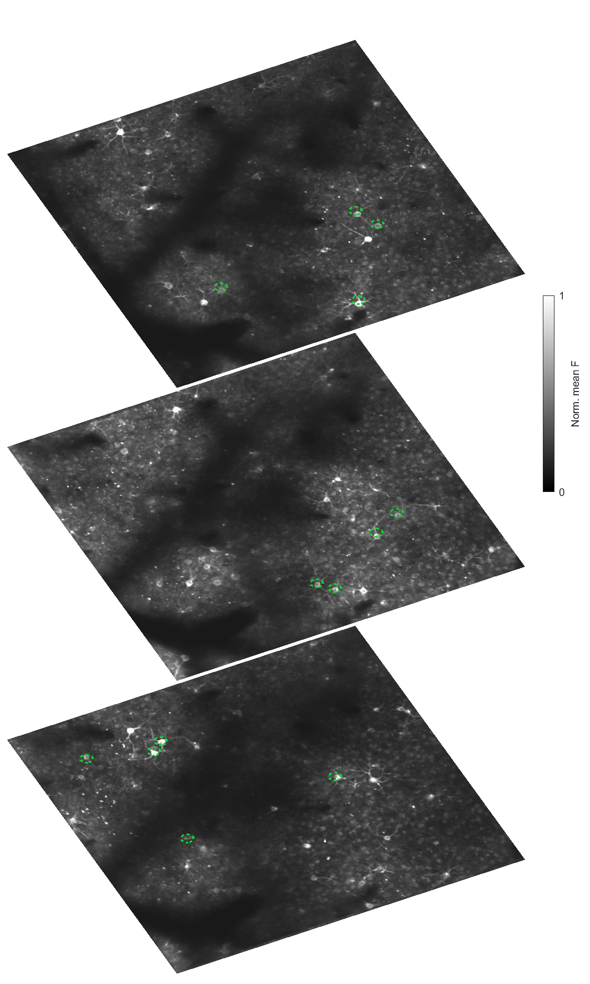
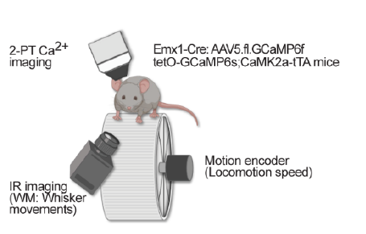
Holographic Imaging and Photo-Stimulation
To ensure each cell has comparable response
Data for future offline analysis
Data for future offline analysis
2p Imaging ~20 min
Quick analysis
2p Imaging + Single cell stimulation ~30 min
Quick analysis
Identify the SLM parameters for each single cell
2P imaging + Holographic photo-stimulation
Data for future offline analysis
Bruker_PrairieLink
Bruker_PVLinkExcuteFolder
Bruker_PVLinkExcuteFolder
Identify ROI of each cell, and their behavioral dependency

Slide 14
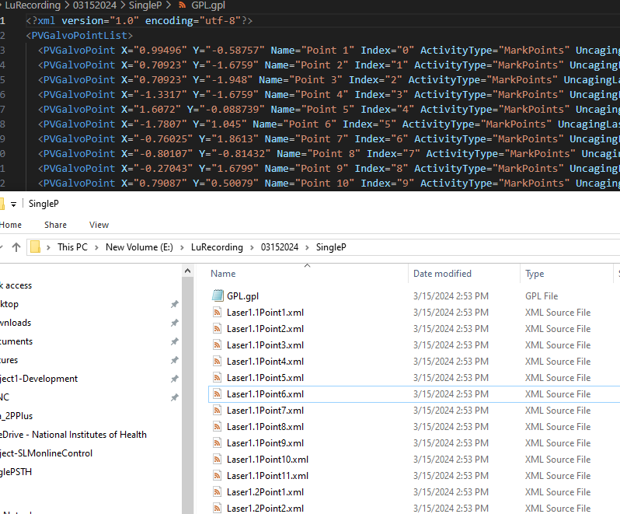
Holographic Imaging and Photo-Stimulation
To ensure each cell has comparable response
Data for future offline analysis
Data for future offline analysis
2p Imaging ~20 min
Quick analysis
2p Imaging + Single cell stimulation ~30 min
Quick analysis
Identify the SLM parameters for each single cell
2P imaging + Holographic photo-stimulation
Data for future offline analysis
Bruker_PrairieLink
Bruker_PVLinkExcuteFolder
Bruker_PVLinkExcuteFolder
Identify ROI of each cell, and their behavioral dependency

Slide 15
Current Issue and Cause
To ensure each cell has comparable response
Data for offline analysis
Data for offline analysis
2p Imaging ~20 min
Quick analysis
2p Imaging + Single cell stimulation ~20 min
Quick analysis
Identify the SLM parameters for each single cell
2P imaging + Holographic photo-stimulation
Data for future offline analysis
Bruker_PrairieLink
Bruker_PVLinkExcuteFolder
Bruker_PVLinkExcuteFolder

Slide 16

Current Issue and Cause
To ensure each cell has comparable response
Data for offline analysis
Data for offline analysis
2p Imaging ~20 min
Quick analysis
2p Imaging + Single cell stimulation ~20 min
Quick analysis
Identify the SLM parameters for each single cell
2P imaging + Holographic photo-stimulation
Data for future offline analysis
Bruker_PrairieLink
Bruker_PVLinkExcuteFolder
Bruker_PVLinkExcuteFolder
Control
Continuous imaging sequence
Data flow
Frame 1
Frame 2
Frame 3

Slide 17
Holographic Imaging and Photo-Stimulation
To ensure each cell has comparable response
Data for analysis
Data for analysis
2p Imaging ~20 min
Quick analysis
2p Imaging + Single cell stimulation ~20 min
Quick analysis
Identify the SLM parameters for each single cell
2P imaging + Holographic photo-stimulation
Data for future offline analysis
Bruker_PrairieLink
Bruker_PVLinkExcuteFolder
Bruker_PVLinkExcuteFolder
Continuous imaging sequence
Pause for SLM in imaging sequence
Data flow
Data flow
Frame 1
Frame 1
Frame 2
Frame 2
Frame 3
Frame 3
Pixels shift after SLM

Slide 18
Holographic Imaging and Photo-Stimulation
Plan B
To ensure each cell has comparable response
Data for analysis
Data for analysis
2p Imaging ~20 min
Quick analysis
2p Imaging + Single cell stimulation ~20 min
Quick analysis
Identify the SLM parameters for each single cell
2P imaging + Holographic photo-stimulation
Data for future offline analysis
Bruker_PrairieLink
Bruker_PVLinkExcuteFolder
Bruker_PVLinkExcuteFolder
Worked but not perfect
Continuous imaging sequence
Pause for SLM in imaging sequence
Data flow
Data flow
Precisely identify the last frame X before SLM
Frame 1
Frame X
Frame 2
Frame 3
Frame X+1
Frame X+2

Slide 19
Future Work and Ideas 1
Currently manual correction after Suite2p process is used, which should be removed to save time
To ensure each cell has comparable response
Data for analysis
Data for analysis
2p Imaging ~20 min
Quick analysis
2p Imaging + Single cell stimulation ~20 min
Quick analysis
Identify the SLM parameters for each single cell
2P imaging + Holographic photo-stimulation
Data for future offline analysis
Bruker_PrairieLink
Bruker_PVLinkExcuteFolder
Bruker_PVLinkExcuteFolder
Identify ROI of each cell, and their behavioral dependency
Make future single target as 1 target + X non-targets
Neural activities with speed (could be online).
Whisker detection could be processed with video-recording PC and quick transfer results to imaging PC

Slide 20
Future Work and Ideas 2
To ensure each cell has comparable response
Data for analysis
Data for analysis
2p Imaging ~20 min
Quick analysis
2p Imaging + Single cell stimulation ~20 min
Quick analysis
Identify the SLM parameters for each single cell
2P imaging + Holographic photo-stimulation
Data for future offline analysis
Bruker_PrairieLink
Bruker_PVLinkExcuteFolder
Bruker_PVLinkExcuteFolder
WM on cells VS non-WM cells VS …
None or “inhibition” networks
None or “excitation” networks

Slide 21
Ideas 3
Data for analysis
Data for analysis
2p Imaging ~20 min
Quick analysis
2p Imaging + Single cell stimulation ~20 min
Closed-loop holographic opto-stimulation
Bruker_PrairieLink
Bruker_PVLinkExcuteFolder
Bruker_PVLinkExcuteFolder
Identify ROI of each cell, and their behavioral dependency
Detection of neural activity pattern (single cell or cell assemblies)
Stimulate other cells

Slide 22
Thank you for support and trouble shooting. Thoughts?

